Slide 1
UNIT 1 15SE205J-PROGRAMMING IN JAVA

Slide 2
Java platform features

Slide 3
Java platform features
1) Compiled and Interpreter:- has both Compiled and Interpreter Feature Program of java is First Compiled and Then it is must to Interpret it .First of all The Program of java is Compiled then after Compilation it creates Bytes Codes rather than Machine Language.
Then After Bytes Codes are Converted into the Machine Language is Converted into the Machine Language with the help of the Interpreter So For Executing the java Program First of all it is necessary to Compile it then it must be Interpreter
2) Platform Independent:- JavaLanguage is Platform Independent means program of java is Easily transferable because after Compilation of java program bytes code will be created then we have to just transfer the Code of Byte Code to another Computer.
This is not necessary for computers having same Operating System in which the code of the java is Created and Executed After Compilation of the Java Program We easily Convert the Program of the java top the another Computer for Execution.
3) Object-Oriented:- We Know that is purely OOP Language that is all the Code of the java Language is Written into the classes and Objects So For This feature java is Most Popular Language because it also Supports Code Reusability, Maintainability etc.

Slide 4
Java platform features…
4) Robust and Secure:- The Code of java is Robust andMeans ot first checks the reliability of the code before Execution When We trying to Convert the Higher data type into the Lower Then it Checks the Demotion of the Code the It Will Warns a User to Not to do this So it is called as Robust.
Secure : When We convert the Code from One Machine to Another the First Check the Code either it is Effected by the Virus or not or it Checks the Safety of the Code if code contains the Virus then it will never Executed that code on to the Machine.
5) Distributed:- Java is Distributed Language Means because the program of java is compiled onto one machine can be easily transferred to machine and Executes them on another machine because facility of Bytes Codes So java is Specially designed For Internet Users which uses the Remote Computers For Executing their Programs on local machine after transferring the Programs from Remote Computers or either from the internet.
6) Simple Small and Familiar:- is a simple Language Because it contains many features of other Languages like c and C++ and Java Removes Complexity because it doesn’t use pointers, Storage Classes and Go to Statements and java Doesn’t support Multiple Inheritance
7) Multithreaded and Interactive:- Java uses Multithreaded Techniques For Execution Means Like in other in Structure Languages Code is Divided into the Small Parts Like These Code of java is divided into the Smaller parts those are Executed by java in Sequence and Timing Manner this is Called as Multithreaded In this Program of java is divided into the Small parts those are Executed by Compiler of java itself Java is Called as Interactive because Code of java Sup
8) Dynamic and Extensible Code:- Java has Dynamic and Extensible Code Means With the Help of OOPS java Provides Inheritance and With the Help of Inheritance we Reuse the Code that is Pre-defined and Also uses all the built in Functions of java and Classes

Slide 5
Java platform features…
9) Distributed:- Java is a distributed language which means that the program can be design to run on computer networks. Java provides an extensive library of classes for communicating ,using TCP/IP protocols such as HTTP and FTP. This makes creating network connections much easier than in C/C++. You can read and write objects on the remote sites via URL with the same ease that programmers are used to when read and write data from and to a file. This helps the programmers at remote locations to work together on the same project.
10) Secure: Java was designed with security in mind. As Java is intended to be used in networked/distributor environments so it implements several security mechanisms to protect you against malicious code that might try to invade your file system.
For example: The absence of pointers in Java makes it impossible for applications to gain access to memory locations without proper authorization as memory allocation and referencing model is completely opaque to the programmer and controlled entirely by the underlying run-time platform .
11) Architectural Neutral: One of the key feature of Java that makes it different from other programming languages is architectural neutral (or platform independent). This means that the programs written on one platform can run on any other platform without having to rewrite or recompile them. In other words, it follows 'Write-once-run-anywhere' approach.
Java programs are compiled into byte-code format which does not depend on any machine architecture but can be easily translated into a specific machine by a Java Virtual Machine (JVM) for that machine. This is a significant advantage when developing applets or applications that are downloaded from the Internet and are needed to run on different systems.

Slide 6
Java platform features…
12) Portable : The portability actually comes from architecture-neutrality. In C/C++, source code may run slightly differently on different hardware platforms because of how these platforms implement arithmetic operations. In Java, it has been simplified.
Unlike C/C++, in Java the size of the primitive data types are machine independent. For example, an int in Java is always a 32-bit integer, and float is always a 32-bit IEEE 754 floating point number. These consistencies make Java programs portable among different platforms such as Windows, Unix and Mac .
13) Interpreted : Unlike most of the programming languages which are either complied or interpreted, Java is both complied and interpreted The Java compiler translates a java source file to bytecodes and the Java interpreter executes the translated byte codes directly on the system that implements the Java Virtual Machine. These two steps of compilation and interpretation allow extensive code checking and improved security .
14) High performance: Java programs are complied to portable intermediate form know as bytecodes, rather than to native machine level instructions and JVM executes Java bytecode on. Any machine on which it is installed. This architecture means that Java programs are faster than program or scripts written in purely interpreted languages but slower than C and C++ programs that compiled to native machine languages.
Although in the early releases of Java, the interpretation of by bytecode resulted in slow performance but the advance version of JVM uses the adaptive and Just in time (JIT) compilation technique that improves performance by converting Java bytecodes to native machine instructions on the fly.

Slide 7
Java technologies-jsr
Java Specification Requests (JSRs) are the actual descriptions of proposed and final specifications for the Java platform. At any one time there are numerous JSRs moving through the review and approval process.
A simple way to stay up to date and track the JSRs in each stage of review is to join the Mailing List. As a Mailing List member, you can automatically receive emails on JSRs as they move through the stages in review.
Of course, at any time, you can see a list of all JSRs, by visiting the Java Specification Requests list. Using the links near the top of the page, you can sort the list by JSR ID number, Title, and the Spec Lead Company Name.
You can also view JSRs by Stage, Technology & Platform or Executive Committee.
The Java Specification Request (JSR) is the first step in developing or revising a Java technology specification (see Section 1 of the Java Community Process document).
Members of the Java Community Process may submit a JSR using the Specification Proposal form.

Slide 8
JAVA TECHNOLOGIES - JCP
The JCP involves the use of Java Specification Requests (JSRs) – the formal documents that describe proposed specifications and technologies for adding to the Java platform. Formal public reviews of JSRs take place before a JSR becomes final and the JCP Executive Committee votes on it. A final JSR provides a reference implementationthat is a free implementation of the technology in source code form and a Technology Compatibility Kit to verify the API specification.

Slide 9
Data Types in Java

Slide 10
What is a Constant?
456—a literal numerical constant
System.out.println(456); // Java
Console.writeline(456); // Visual C#
“A Literal String Constant”
System.out.println(“My First Java”); // Java
Console.writeline(“My First C#”); // Visual C#

Slide 11
What is a variable?
It is a named computer location in memory that holds values that might vary
Must that location have an address?
YES
What has addresses? Bits, bytes, words, what?
Bytes
Can a variable be more than one byte long?
YES

Slide 12
Data type Declarations
Specify the type of data and the length of the data item in bytes
int, short, long
float, double
boolean
char

Slide 13
Data Types -- Integer
Int – the default declaration – 4-byte integer
Byte—1-byte integer
Short—2-byte integer
Long—8-byte integer

Slide 14
Floating Point
Float—a 4-byte floating point number
Double—an 8-byte floating point number

Slide 15
There are eight primitive data types
Name them
Boolean, byte, char, double, float, int, long, short
In bytes, how long is the short data type? The int data type, the long data type?
In bytes, how long is the float data type? The double data type?
How long is the char data type?

Slide 16
Primitives sizes and Ranges
PRIMITIVE | SIZE IN BITS | RANGE
int | 32 | -2 to the 31st to 2 to the 31st
int | 4 bytes | 2147483648
long | 64 -- 8 bytes | -2 to the 63rd to 2 to the 63rd
float | 32 | +- 1.5 x 10^45
double | 64 | +- 5.0 x 10^324
decimal (C# only) | 128 | 28 significant figures
string | 16 bits per char | Not applicable
char | 16 | One character
bool (boolean in Java) | 8 | True or false

Slide 17
The assignment operator =
A = 36;
Sets a = to the constant 36 at execution time
Int A =36;
Sets A = to the constant 36 at compile time
Initializes A to 36 at the time memory is set aside for it

Slide 18
Simple Arithmetic Operators
* / % (multiplication, division, modulus)
+ - (addition, subtraction—on a lower level of the precedence hierarchy)
int result = 2 + 3 * 4;
Is result 14 or 20??
int result = (2 + 3) * 4

Slide 19
Binary Operators
The simple arithmetic operators are also called binary operators because they have two operands exactly
Never three
Never one

Slide 20
Using the Boolean data type
Boolean variables can hold only one of two values—true or false
Boolean isItPayday = false;
Boolean areYouBroke = true;

Slide 21
Comparison operators
The result is boolean, always
< less than
> greater than
== equal to
<= less than or equal to
>= greater than or equal to
!= not equal to

Slide 22
Boolean examples
boolean is SixBigger = (6 > 5);
// value stored in is SixBigger is true
Boolean is SevenSmaller = (7 <= 4);
// value stored in is SevenSmaller is false

Slide 23
Data formats
The character format—uses an assigned decimal value
The integer format
The floating point format—consists of an exponent part and a mantissa part—for example the 4-byte floating point word might have a 1-byte exponent and a 3-byte mantissa.

Slide 24
What happens when you try to do arithmetic with different data types?
The lower-level data type is converted to the higher-level data type before the binary operation is performed
double
float
long
int

Slide 25
Example
int hoursWorked = 37;
Double payRate = 6.73;
Double grossPay = hoursWorked * payRate;
Here, hoursWorked is converted from int to double before the * operation is performed; the result, grossPay contains 249.01 stored as a double

Slide 26
Type casting
Forces a value of one data type to be used as a value of another type
Example
Double bankBalance = 189.66;
Float weeklyBudget = (float) bankBalance / 4;
/* weeklyBudget is 47.415, one-forth of bankBalance */

Slide 27
In the above…
Without the use of the (float), the code segment would not compile

Slide 28
Another type casting example
float myMoney = 47.82f;
int dollars = (int) myMoney;
// dollars is 47, the integer part of myMoney
// note that myMoney was not rounded

Slide 29
The char data type
Holds only a single character
Legal Examples
char myMiddleInitial = ‘M’;
char myGradeInChemistry = ‘A’;
char aStar = ‘*’;
char aCharValue = ‘9’;
char aNewLine = ‘\n’;
char aTabChar = ‘\t’;

Slide 30
In the latter two cases above…
The char variables still hold a single character
The backslash gives a new meaning to the character that follows
The pair together represents a single nonprinting character

Slide 31
To hold strings in a variable…
Use the string class that is built-in
string firstName = “Audrey”;

Slide 32
Using the Joption Pane Class for GUI Input
An input dialog box asks a question and provides a text field in which the user can enter a response.
The user’s response is returned by the method and placed in a string variable

Slide 33
An example
Import javax.swing.JOptionPane;
Public class HelloNameDialog
{
Public static void main(string[] args)
{
String result;
result = JOptionPane.ShowInputDialog(“What is your name?”);
JOptionPane.showMessageDialog(null, “Hello, “ + result + “!”);
System.exit(0);
}
}

Slide 34
Using Methods, classes, and Objects
Methods are similar to procedures, functions, or subroutines
Statements within a method execute only when the method is called
To execute a method, you call it from another method
“The calling method makes a method call”

Slide 35
Simple methods….
Don’t require any data items (arguments or parameters), nor do they return any data items back
You can create a method once and use it many times in different contexts

Slide 36
Example
Public class First
{
Public static void main(String[] args)
{
System.out.println(“First Java application”);
}
}

Slide 37
Method Declaration
Is the first line or header of a method and contains
Optional access modifiers
The return type for the method
The method name
An opening parenthesis
An optional list of method arguments separated by commas
A closing parenthesis

Slide 38
Access Modifiers
public – accessible anywhere
private – accessible only within the class in which it is defined
protected – allows members of a derived class to access members of its parent classes
static – does not require instantiation before it can be used and remains in place after use, without being destroyed

Slide 39
Java Keywords

Slide 40
class
Indicates the start of the definition of a class.
public class Name {
}

Slide 41
new
Indicates a call to a constructor
Used when you want to create a new instance of an object
Use:
new constructorName();

Slide 42
package
Indicates membership for a class in a particular package
Packages correspond to directories on the file system
Use:
package nameOfPackage;

Slide 43
private
Access control modifier (visibility)
Only accessible from within the class

Slide 44
public
Access control modifier (visibility)
Accessible from everywhere and to everyone

Slide 45
void
Used as a return type for a method.
Indicates that the method does not return anything.
public void methodName() {
}

Slide 46
extends
Indicates that the class you are writing has a superclass, which is an indication of inheritance.
public class ClassName extends SuperClassName {
}

Slide 47
this
Self-reference
Refers to the class itself
Can be used to have the class call its own method
this.methodName();

Slide 48
return
Needed to indicate what value is being returned from a method that has a return type.
public NonVoidType methodName() {
//do some work
return someValue;
}

Slide 49
super
Indicates a call to the superclass’ method (either constructor or just a regular method).
public ConstructorName() {
super(param);
}
public void OverriddenMethod() {
super.OverriddenMethod();
}

Slide 50
interface
Indicates the beginning of an interface definition.
public interface InterfaceName {
}

Slide 51
abstract
Indicates that a method is abstract (does not have a method body).
public abstract void method();
OR
abstract public void method();

Slide 52
implements
Indicates that the class you are writing implements an interface.
public class Name implements InterfaceName{
}

Slide 53
SCOPING RULES IN JAVA
Disallowing them altogether. Very rare; though some languages may disallow free references to all but a pre-defined set of symbols (often called keywords or special forms) which are provided by the language.
Only two scoping levels - global and local. CeeLanguage and many assemblers use this rule. A FreeVariable defined in a C function must refer to a "global" symbol (meaning defined either at file or global scope; as opposed to within a function body). This simplifies the implementation of C greatly (and many C programmers don't miss more advanced scope rules at all). CeePlusPlus sticks to the C tradition in many ways, though the presence of features such as classes and namespaces cause C++ to relax the scoping rules quite a bit. (Still, no C++ function can bind to the local variables of another C++ function). Java, with InnerClasses, relaxes the scoping rules further.

Slide 54
SCOPING RULES IN JAVA
The scoping rules of a ProgrammingLanguage dictate how FreeVariables - symbol names which are found in the body of a scope (a function, macro, class, whatever) but not defined there - are resolved.
Several different strategies exist:
Disallowing them altogether. Very rare; though some languages may disallow free references to all but a pre-defined set of symbols (often called keywords or special forms) which are provided by the language.

Slide 55
SCOPING RULES
Only two scoping levels - global and local. CeeLanguage and many assemblers use this rule. A FreeVariable defined in a C function must refer to a "global" symbol (meaning defined either at file or global scope; as opposed to within a function body). This simplifies the implementation of C greatly (and many C programmers don't miss more advanced scope rules at all). CeePlusPlus sticks to the C tradition in many ways, though the presence of features such as classes and namespaces cause C++ to relax the scoping rules quite a bit. (Still, no C++ function can bind to the local variables of another C++ function). Java, with InnerClasses, relaxes the scoping rules further.

Slide 56
SCOPING RULES
DynamicScoping (early dialects of Lisp, CommonLisp special variables, exported environment variables in UnixOs): The caller is checked for a binding for the variable; if one is found, it is used. Otherwise, the caller's caller is checked, and so on. If no definition is found, it is either an error or a default value is used, depending on the semantics of the language.

Slide 57
SCOPING RULES(Example)
int main void
{
const char *scope = "Lexical, deep, by copy ";
void print_scope (void)
{
printf ("%s\n", scope);
}

Slide 58
Scoping rules
void do_it (void)
{
const char *scope = "Dynamic Scoping";
helper_func()(); /* Call the function returned by helper_func(); */
}
do_it(); /* Print what scoping we are using */
}

Slide 59
Type casting
Forces a value of one data type to be used as a value of another type
Example
Double bankBalance = 189.66;
Float weeklyBudget = (float) bankBalance / 4;
/* weeklyBudget is 47.415, one-forth of bankBalance */

Slide 60
Data Type Conversion and Casting
In any program it is recommendable to only perform arithmetic operations on pairs of values of the same type.
When compatible types are mixed in an assignment, the value of the right side is automatically converted to the type of the left side.
However, because of Java’s strict type checking, not all types are compatible, and thus, not all type conversions are implicitly allowed.

Slide 61
For example, boolean and int are not compatible.
When one type of data is assigned to another type of variable, an automatic type conversion will take place if
The two types are compatible.
The destination type is larger than source type.
When these two conditions are met, a widening conversion takes place.
For example, the int type is always large enough to hold all valid byte values, and both int and byte are integer types, so an automatic conversion from byte to int can be applied.

Slide 62
For widening conversions, the numeric types, including integer and floating-point types, are compatible with each other.
There are no automatic conversions from the numeric types to char or boolean. Also, char and boolean are not compatible with each other.
However, an integer literal can be assigned to char.

Slide 63
Although the automatic type conversions are helpful, they will not fulfill all programming needs because they apply only to widening conversions between compatible types.
For all other cases you must employ a cast.
A cast is an instruction to the compiler to convert one type into another.
Thus, it requests an explicit type conversion. A cast has this general form:
(target-type) expression
Here, target-type specifies the desired type to convert the specified expression to.

Slide 64
For example, if you want to convert the type of the expression x/y to int, you can write
double x, y;
//…
(int)(x/y)
The parentheses surrounding x/y are necessary. Otherwise, the cast to int would apply only to the x and not to the outcome of the division.
The cast is necessary here because there is no automatic conversion from double to int.

Slide 65
When a cast involves a narrowing conversion, information might be lost.
For example, when casting a long into a short, information will be lost if the long’s value is greater than the range of a short because its high-order bits are removed.
When a floating-point value is cast to an integer type, the fractional component will also be lost due to truncation.

Slide 66
package conversion;
public class Main
{
public static void main(String[] args)
{
int var1=12;
double var2=45.8921;
double result=var1+var2;
char letter=65;
System.out.println("The sum gives "+result);
System.out.println("The letter is "+letter);
}
}
run:
The sum gives 57.8921
The letter is A
BUILD SUCCESSFUL (total time: 0 seconds)

Slide 67
package casting;
public class Main
{
public static void main(String[] args)
{
double x=10.0, y=3.0;
int i=(int)(x/y);
System.out.println("Integer outcome was: "+i);
}
}
run:
Integer outcome was: 3
BUILD SUCCESSFUL (total time: 1 second)

Slide 68
Arrays in JAVA

Slide 69
Declaring an Array Variable
Do not have to create an array while declaring array variable
<data type> [] variable_name;
int [] prime;
int prime[];
Both syntaxes are equivalent
No memory allocation at this point

Slide 70
Defining an Array
Define an array as follows:
variable_name=new <data type>[N];
primes=new int[10];
Declaring and defining in the same statement:
int[] primes=new int[10];
In JAVA, int is of 4 bytes, total space=4*10=40 bytes

Slide 71
Graphical Representation
Index
prime
0 | 1 | 2 | 3 | 4 | 5 | 6 | 7 | 8 | 9
2 | 1 | 11 | -9 | 2 | 1 | 11 | 90 | 101 | 2
value

Slide 72
What happens if …
We define
int[] prime=new long[20];
MorePrimes.java:5: incompatible types
found: long[]
required: int[]
int[] primes = new long[20];
^
The right hand side defines an array, and thus the array variable should refer to the same type of array

Slide 73
Array Size through Input
BufferedReader stdin = new BufferedReader (new InputStreamReader(System.in));
String inData;
int num;
System.out.println("Enter a Size for Array:");
inData = stdin.readLine();
num = Integer.parseInt( inData ); // convert inData to int
long[] primes = new long[num];
System.out.println(“Array Length=”+primes.length);
….
SAMPLE RUN:
Enter a Size for Array:
4
Array Length=4

Slide 74
Default Initialization
When array is created, array elements are initialized
Numeric values (int, double, etc.) to 0
Boolean values to false
Class types to null

Slide 75
Accessing Array Elements
Index of an array is defined as
Positive int, byte or short values
Expression that results into these types
Any other types used for index will give error
long, double, etc.
Incase Expression results in long, then type cast to int
Indexing starts from 0 and ends at N-1
primes[2]=0;
int k = primes[2];
…

Slide 76
Validating Indexes
JAVA checks whether the index values are valid at runtime
If index is negative or greater than the size of the array then an IndexOutOfBoundException will be thrown
Program will normally be terminated unless handled in the try {} catch {}

Slide 77
What happens if …
long[] primes = new long[20];
primes[25]=33;
….
Runtime Error:
Exception in thread “main” java.lang.ArrayIndexOutOfBoundsException: 25
at MorePrimes.main(MorePrimes.java:6)

Slide 78
Reusing Array Variables
Array variable is separate from array itself
Like a variable can refer to different values at different points in the program
Use array variables to access different arrays
int[] primes=new int[10];
……
primes=new int[50];
Previous array will be discarded
Cannot alter the type of array

Slide 79
Demonstration
long[] primes = new long[20];
primes[0] = 2;
primes[1] = 3;
long[] primes2=primes;
System.out.println(primes2[0]);
primes2[0]=5;
System.out.println(primes[0]);

Slide 80
Output
2
5

Slide 81
Array Length
Refer to array length using length
A data member of array object
array_variable_name.length
for(int k=0; k<primes.length;k++)
….
Sample Code:
long[] primes = new long[20];
System.out.println(primes.length);
Output: 20

Slide 82
Sample Program
class MinAlgorithm
{
public static void main ( String[] args )
{
int[] array = { -20, 19, 1, 5, -1, 27, 19, 5 } ;
int min=array[0]; // initialize the current minimum
for ( int index=0; index < array.length; index++ )
if ( array[ index ] < min )
min = array[ index ] ;
System.out.println("The minimum of this array is: " + min );
}
}
*Program taken from: http://chortle.ccsu.edu/CS151/Notes/chap47/ch47_10.html

Slide 83
Arrays of Arrays
Two-Dimensional arrays
float[][] temperature=new float[10][365];
10 arrays each having 365 elements
First index: specifies array (row)
Second Index: specifies element in that array (column)
In JAVA float is 4 bytes, total Size=4*10*365=14,600 bytes

Slide 84
Initializing Array of Arrays
int[][] array2D = { {99, 42, 74, 83, 100}, {90, 91, 72, 88, 95}, {88, 61, 74, 89, 96}, {61, 89, 82, 98, 93}, {93, 73, 75, 78, 99}, {50, 65, 92, 87, 94}, {43, 98, 78, 56, 99} };
//5 arrays with 5 elements each

Slide 85
Initializing Varying Size Arrays
int[][] uneven = { { 1, 9, 4 }, { 0, 2}, { 0, 1, 2, 3, 4 } };
//Three arrays
//First array has 3 elements
//Second array has 2 elements
//Third array has 5 elements

Slide 86
Precedence and associativity of Java operators.
The table below shows all Java operators from highest to lowest precedence, along with their associativity. Most programmers do not memorize them all, and even those that do still use parentheses for clarity.

Slide 87
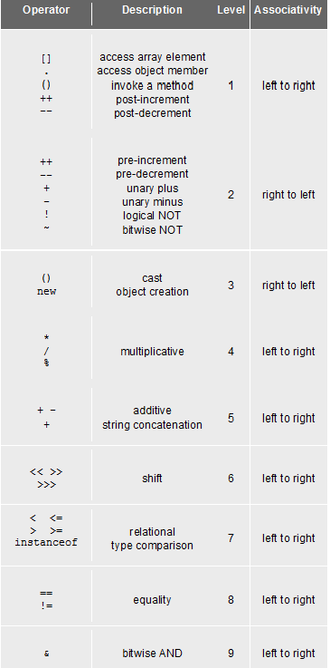
Precedence and associativity of Java operators.
Operator | Description | Level | Associativity
[] . () ++ -- | access array element access object member invoke a method post-increment post-decrement | 1 | left to right
++ -- + - ! ~ | pre-increment pre-decrement unary plus unary minus logical NOT bitwise NOT | 2 | right to left
() new | cast object creation | 3 | right to left
* / % | multiplicative | 4 | left to right
+ - + | additive string concatenation | 5 | left to right
<< >> >>> | shift | 6 | left to right
< <=> >= instanceof | relational type comparison | 7 | left to right
== != | equality | 8 | left to right
& | bitwise AND | 9 | left to right
^ | bitwise XOR | 10 | left to right
| | bitwise OR | 11 | left to right
&& | conditional AND | 12 | left to right
|| | conditional OR | 13 | left to right
?: | conditional | 14 | right to left
= += -= *= /= %= &= ^= |=<<= >>= >>>= | assignment | 15 | right to left

Slide 88
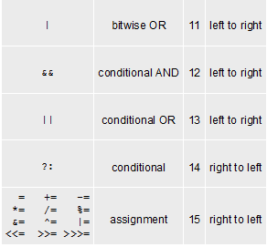

Slide 89
Expressions in Java
The heart of the Add2Integers program from Chapter 2 is the line
int total = n1 + n2;
that performs the actual addition.
The n1 + n2 that appears to the right of the equal sign is an example of an expression, which specifies the operations involved in the computation.
An expression in Java consists of terms joined together by operators.
Each term must be one of the following:
A constant (such as 3.14159265 or "hello, world")
A variable name (such as n1, n2, or total)
A method calls that returns a values (such as readInt)
An expression enclosed in parentheses

Slide 90
Primitive Data Types
Although complex data values are represented using objects, Java defines a set of primitive types to represent simple data.
Of the eight primitive types available in Java, the programs in this text use only the following four:
int
This type is used to represent integers, which are whole numbers such as 17 or –53.
double
This type is used to represent numbers that include a decimal fraction, such as 3.14159265. In Java, such values are called floating-point numbers; the name double comes from the fact that the representation uses twice the minimum precision.
boolean
This type represents a logical value (true or false).
char
This type represents a single character and is described in Chapter 8.

Slide 91
Summary of the Primitive Types
A data type is defined by a set of values called the domain and a set of operations. The following table shows the data domains and common operations for all eight of Java’s primitive types:
Type
Domain
Common operations
byte
8-bit integers in the range –128 to 127
The arithmetic operators:
add
multiply
+
*
subtract
divide
short
16-bit integers in the range –32768 to 32767
-
/
remainder
%
int
32-bit integers in the range
–2146483648 to 2146483647
The relational operators:
equal to
not equal
= =
!=
less than
less or equal
64-bit integers in the range
–9223372036754775808 to 9223372036754775807
<
<=
long
>
greater than
greater or equal
>=
32-bit floating-point numbers in the range
± 1.4 ^{x} 10⁻⁴⁵ to ± 3.4028235 ^{x} 10⁻³⁸
float
The arithmetic operators except %
64-bit floating-point numbers in the range
± 4.39 ^{x} 10⁻³²² to ± 1.7976931348623157 ^{x} 10³⁰⁸
The relational operators
double
char
16-bit characters encoded using Unicode
The relational operators
The logical operators:
boolean
the values true and false
add
or
not
&&
||
!

Slide 92
Constants and Variables
The simplest terms that appear in expressions are constants and variables. The value of a constant does not change during the course of a program. A variable is a placeholder for a value that can be updated as the program runs.
The format of a constant depends on its type:
Integral constants consist of a string of digits, optionally preceded by a minus sign, as in 0, 42, -1, or 1000000.
Floating-point constants include a decimal point, as in 3.14159265 or 10.0. Floating-point constants can also be expressed in scientific notation by adding the letter E and an exponent after the digits of the number, so that 5.646E-8 represents the number 5.646 x 10⁻⁸.
The two constants of type boolean are true and false.
Character and string constants are discussed in detail in Chapter 8. For the moment, all you need to know is that a string constant consists of a sequence of characters enclosed in double quotation marks, such as "hello, world".
A variable in Java is most easily envisioned as a box capable of storing a value.
total
42
(contains an int)
Each variable has the following attributes:
A name, which enables you to differentiate one variable from another.
A type, which specifies what type of value the variable can contain.
A value, which represents the current contents of the variable.
The name and type of a variable are fixed. The value changes whenever you assign a new value to the variable.

Slide 93
Java Identifiers
Names for variables (and other things) are called identifiers.
Identifiers in Java conform to the following rules:
A variable name must begin with a letter or the underscore character.
The remaining characters must be letters, digits, or underscores.
The name must not be one of Java’s reserved words:
abstract
boolean
break
byte
case
catch
char
class
const
continue
default
do
double
else
extends
false
final
finally
float
for
goto
if
implements
import
instanceof
int
interface
long
native
new
null
package
private
protected
public
return
short
static
strictfp
super
switch
synchronized
this
throw
throws
transient
true
try
void
volatile
while
Identifiers should make their purpose obvious to the reader.
Identifiers should adhere to standard conventions. Variable names, for example, should begin with a lowercase letter.

Slide 94
Variable Declarations
In Java, you must declare a variable before you can use it. The declaration establishes the name and type of the variable and, in most cases, specifies the initial value as well.
The most common form of a variable declaration is
type name = value;
where type is the name of a Java primitive type or class, name is an identifier that indicates the name of the variable, and value is an expression specifying the initial value.
Most declarations appear as statements in the body of a method definition. Variables declared in this way are called local variables and are accessible only inside that method.
Variables may also be declared as part of a class. These are called instance variables and are covered in Chapter 6.

Slide 95
Operators and Operands
As in most languages, Java programs specify computation in the form of arithmetic expressions that closely resemble expressions in mathematics.
The most common operators in Java are the ones that specify arithmetic computation:
+
Addition
*
Multiplication
–
Subtraction
/
Division
%
Remainder
Operators in Java usually appear between two subexpressions, which are called its operands. Operators that take two operands are called binary operators.
The - operator can also appear as a unary operator, as in the expression -x, which denotes the negative of x.

Slide 96
Division and Type Casts
Whenever you apply a binary operator to numeric values in Java, the result will be of type int if both operands are of type int, but will be a double if either operand is a double.
This rule has important consequences in the case of division. For example, the expression
14 / 5
seems as if it should have the value 2.8, but because both operands are of type int, Java computes an integer result by throwing away the fractional part. The result is therefore 2.
If you want to obtain the mathematically correct result, you need to convert at least one operand to a double, as in
(double) 14 / 5
The conversion is accomplished by means of a type cast, which consists of a type name in parentheses.

Slide 97
The Pitfalls of Integer Division
Consider the following Java statements, which are intended to convert 100˚ Celsius temperature to its Fahrenheit equivalent:
double c = 100;
double f = 9 / 5 * c + 32;
The computation consists of evaluating the following expression:
9 / 5 * c + 32
The problem arises from the fact that both 9 and 5 are of type int, which means that the result is also an int.
132
100
1
9 / 5 * c + 32

Slide 98
The Pitfalls of Integer Division
You can fix this problem by converting the fraction to a double, either by inserting decimal points or by using a type cast:
double c = 100;
double f = (double) 9 / 5 * c + 32;
The computation now looks like this:
212.0
180.0
1.8
9.0
(double) 9 / 5 * c + 32

Slide 99
The Remainder Operator
The only arithmetic operator that has no direct mathematical counterpart is %, which applies only to integer operands and computes the remainder when the first divided by the second:
14 % 5
returns
4
14 % 7
returns
0
7 % 14
returns
7
The result of the % operator make intuitive sense only if both operands are positive. The examples in this book do not depend on knowing how % works with negative numbers.
The remainder operator turns out to be useful in a surprising number of programming applications and is well worth a bit of study.

Slide 100
Precedence
If an expression contains more than one operator, Java uses precedence rules to determine the order of evaluation. The arithmetic operators have the following relative precedence:
unary - (type cast)
highest
* / %
+ -
lowest
Thus, Java evaluates unary - operators and type casts first, then the operators *, /, and %, and then the operators + and -.
Precedence applies only when two operands compete for the same operator. If the operators are independent, Java evaluates expressions from left to right.
Parentheses may be used to change the order of operations.

Slide 101
Exercise: Precedence Evaluation
What is the value of the expression at the bottom of the screen?
42
32
0
32
0
4
3
30
8
(
1
+
2
)
%
3
*
4
+
5
*
6
/
7
*
(
8
%
9
)
+
10

Slide 102
Assignment Statements
You can change the value of a variable in your program by using an assignment statement, which has the general form:
variable = expression;
The effect of an assignment statement is to compute the value of the expression on the right side of the equal sign and assign that value to the variable that appears on the left. Thus, the assignment statement
total = total + value;
adds together the current values of the variables total and value and then stores that sum back in the variable total.
When you assign a new value to a variable, the old value of that variable is lost.

Slide 103
Shorthand Assignments
Statements such as
total = total + value;
are so common that Java allows the following shorthand form:
total += value;
The general form of a shorthand assignment is
variable op= expression;
where op is any of Java’s binary operators. The effect of this statement is the same as
variable = variable op (expression);
For example, the following statement multiplies salary by 2.
salary *= 2;

Slide 104
Increment and Decrement Operators
Another important shorthand form that appears frequently in Java programs is the increment operator, which is most commonly written immediately after a variable, like this:
x++;
The effect of this statement is to add one to the value of x, which means that this statement is equivalent to
x += 1;
or in an even longer form
x = x + 1;
The -- operator (which is called the decrement operator) is similar but subtracts one instead of adding one.
The ++ and -- operators are more complicated than shown here, but it makes sense to defer the details until Chapter 11.

Slide 105
Boolean Expressions
In many ways, the most important primitive type in Java is boolean, even though it is by far the simplest. The only values in the boolean domain are true and false, but these are exactly the values you need if you want your program to make decisions.
The name boolean comes from the English mathematician George Boole who in 1854 wrote a book entitled An Investigation into the Laws of Thought, on Which are Founded the Mathematical Theories of Logic and Probabilities. That book introduced a system of logic that has come to be known as Boolean algebra, which is the foundation for the boolean data type.
George Boole (1791-1871)

Slide 106
Boolean Operators
The operators used with the boolean data type fall into two categories: relational operators and logical operators.
There are six relational operators that compare values of other types and produce a boolean result:
= =
Equals
!=
Not equals
<
Less than
<=
Less than or equal to
>
Greater than
>=
Greater than or equal to
For example, the expression n <= 10 has the value true if x is less than or equal to 10 and the value false otherwise.
There are also three logical operators:
Logical AND
&&
p && q means both p and q
Logical OR
||
p || q means either p or q (or both)
!
Logical NOT
!p means the opposite of p

Slide 107
Notes on the Boolean Operators
Remember that Java uses = to denote assignment. To test whether two values are equal, you must use the = = operator.
It is not legal in Java to use more than one relational operator in a single comparison as is often done in mathematics. To express the idea embodied in the mathematical expression
0 ≤ x ≤ 9
you need to make both comparisons explicit, as in
0 <= x && x <= 9
The || operator means either or both, which is not always clear in the English interpretation of or.
Be careful when you combine the ! operator with && and || because the interpretation often differs from informal English.

Slide 108
Short-Circuit Evaluation
Java evaluates the && and || operators using a strategy called short-circuit mode in which it evaluates the right operand only if it needs to do so.
For example, if n is 0, the right hand operand of && in
n != 0 && x % n == 0
is not evaluated at all because n != 0 is false. Because the expression
false && anything
is always false, the rest of the expression no longer matters.
One of the advantages of short-circuit evaluation is that you can use && and || to prevent execution errors. If n were 0 in the earlier example, evaluating x % n would cause a “division by zero” error.

Slide 109
Designing for Change
While it is clearly necessary for you to write programs that the compiler can understand, good programmers are equally concerned with writing code that people can understand.
The importance of human readability arises from the fact that programs must be maintained over their life cycle. Typically, as much as 90 percent of the programming effort comes after the initial release of a system.
There are several useful techniques that you can adopt to increase readability:
Use names that clearly express the purpose of variables and methods
Use proper indentation to make the structure of your programs clear
Use named constants to enhance both readability and maintainability

Slide 110
Flow Control

Slide 111
Objectives
learn about Java branching statements
learn about loops
learn about the type boolean

Slide 112
Flow of Control
Flow of control is the order in which a program performs actions.
Up to this point, the order has been sequential.
A branching statement chooses between two or more possible actions.
A loop statement repeats an action until a stopping condition occurs.

Slide 113
Branching Statements: Outline
The if-else Statement
Introduction to Boolean Expressions
Nested Statements and Compound Statements
Multibranch if-else Statements
The switch Statament
(optional) The Conditional Operator

Slide 114
The if-else Statement
A branching statement that chooses between two possible actions.
syntax
if (Boolean_Expression)
Statement_1
else
Statement_2

Slide 115
The if-else Statement, cont.
example
if (count < 3)
total = 0;
else
total = total + count;

Slide 116
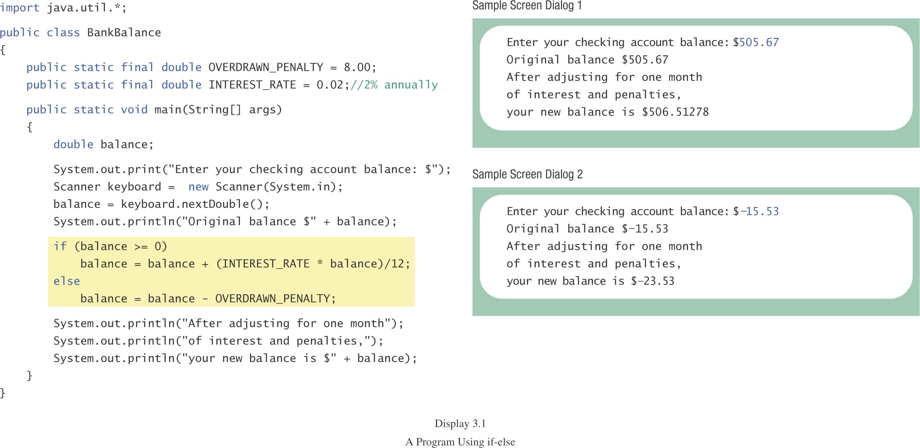
The if-else Statement, cont.
class BankBalance

Slide 117
Compound Statements
To include multiple statements in a branch, enclose the statements in braces.
if (count < 3)
{
total = 0;
count = 0;
}

Slide 118
Omitting the else Part
If the else part is omitted and the expression after the if is false, no action occurs.
syntax
if (Boolean_Expression)
Statement
example
if (weight > ideal)
caloriesPerDay -= 500;

Slide 119
Introduction to Boolean Expressions
The value of a boolean expression is either true or false.
examples
time < limit
balance <= 0

Slide 120
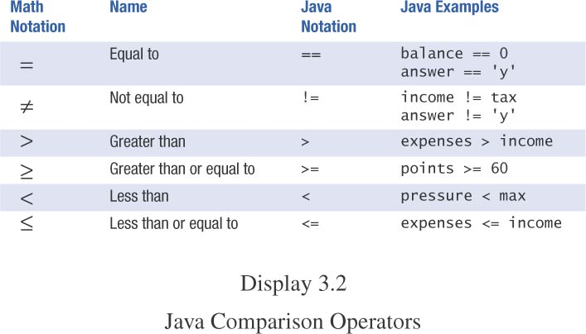
Java Comparison Operators

Slide 121
Compound Boolean Expressions
Boolean expressions can be combined using the “and” (&&) operator.
example
if ((score > 0) && (score <= 100))
...
not allowed
if (0 < score <= 100)
...

Slide 122
Compound Boolean Expressions, cont.
syntax
(Sub_Expression_1) && (Sub_Expression_2)
Parentheses often are used to enhance readability.
The larger expression is true only when both of the smaller expressions are true.

Slide 123
Compound Boolean Expressions, cont.
Boolean expressions can be combined using the “or” (||) operator.
example
if ((quantity > 5) || (cost < 10))
...
syntax
(Sub_Expression_1) || (Sub_Expression_2)

Slide 124
Compound Boolean Expressions, cont.
The larger expression is true
when either of the smaller expressions is true
when both of the smaller expressions are true.
“or” in Java is inclusive or
either or both to be true.
exclusive or
one or the other, but not both to be true.

Slide 125
Negating a Boolean Expression
Boolean negation
“not” (!) operator.
syntax
!Boolean_Expression
Example:
Boolean walk = false;
System.out.println(!walk);

Slide 126
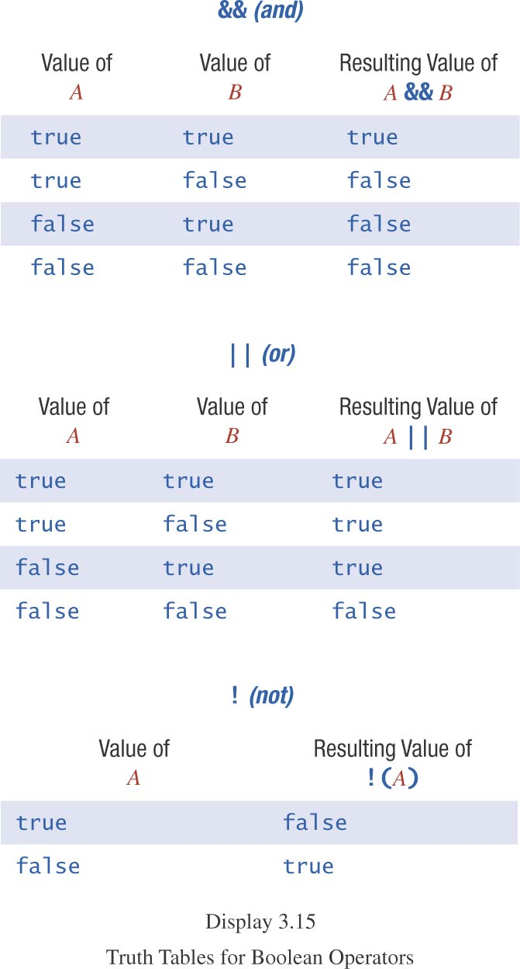
Truth Tables

Slide 127
Primary Logical Operators
Primary logical operators: and, or, not
Any logical expression can be composed
Example: exclusive or
(a || b) && !(a && b)
Either work or play:
(work || play) && !(work && play)
^ is exclusive-or in Java
work ^ play
not a logical operator in most languages

Slide 128
Using ==
== is appropriate for determining if two integers or characters have the same value.
if (a == 3)
where a is an integer type
== is not appropriate for determining if two floating point values are equal.
Use < and some appropriate tolerance instead.
if (Math.abs(b - c) < epsilon)
b, c, and epsilon are of floating point type
[www.cs.fit.edu/~pkc/classes/cse1001/FloatEquality.java]

Slide 129
Using ==, cont.
== is not appropriate for determining if two objects have the same value.
if (s1 == s2)
determines only if s1 and s2 are at the same memory location.
If s1 and s2 refer to strings with identical sequences of characters, but stored in different memory locations
(s1 == s2) is false.

Slide 130
Using ==, cont.
To test the equality of objects of class String, use method equals.
s1.equals(s2)
or
s2.equals(s1)
www.cs.fit.edu/~pkc/classes/cse1001/StringEqual.java
To test for equality ignoring case, use method equalsIgnoreCase.
(“Hello”.equalsIgnoreCase(“hello”))

Slide 131
equals and equalsIgnoreCase
syntax
String.equals(Other_String)
String.equalsIgnoreCase(Other_String)

Slide 132
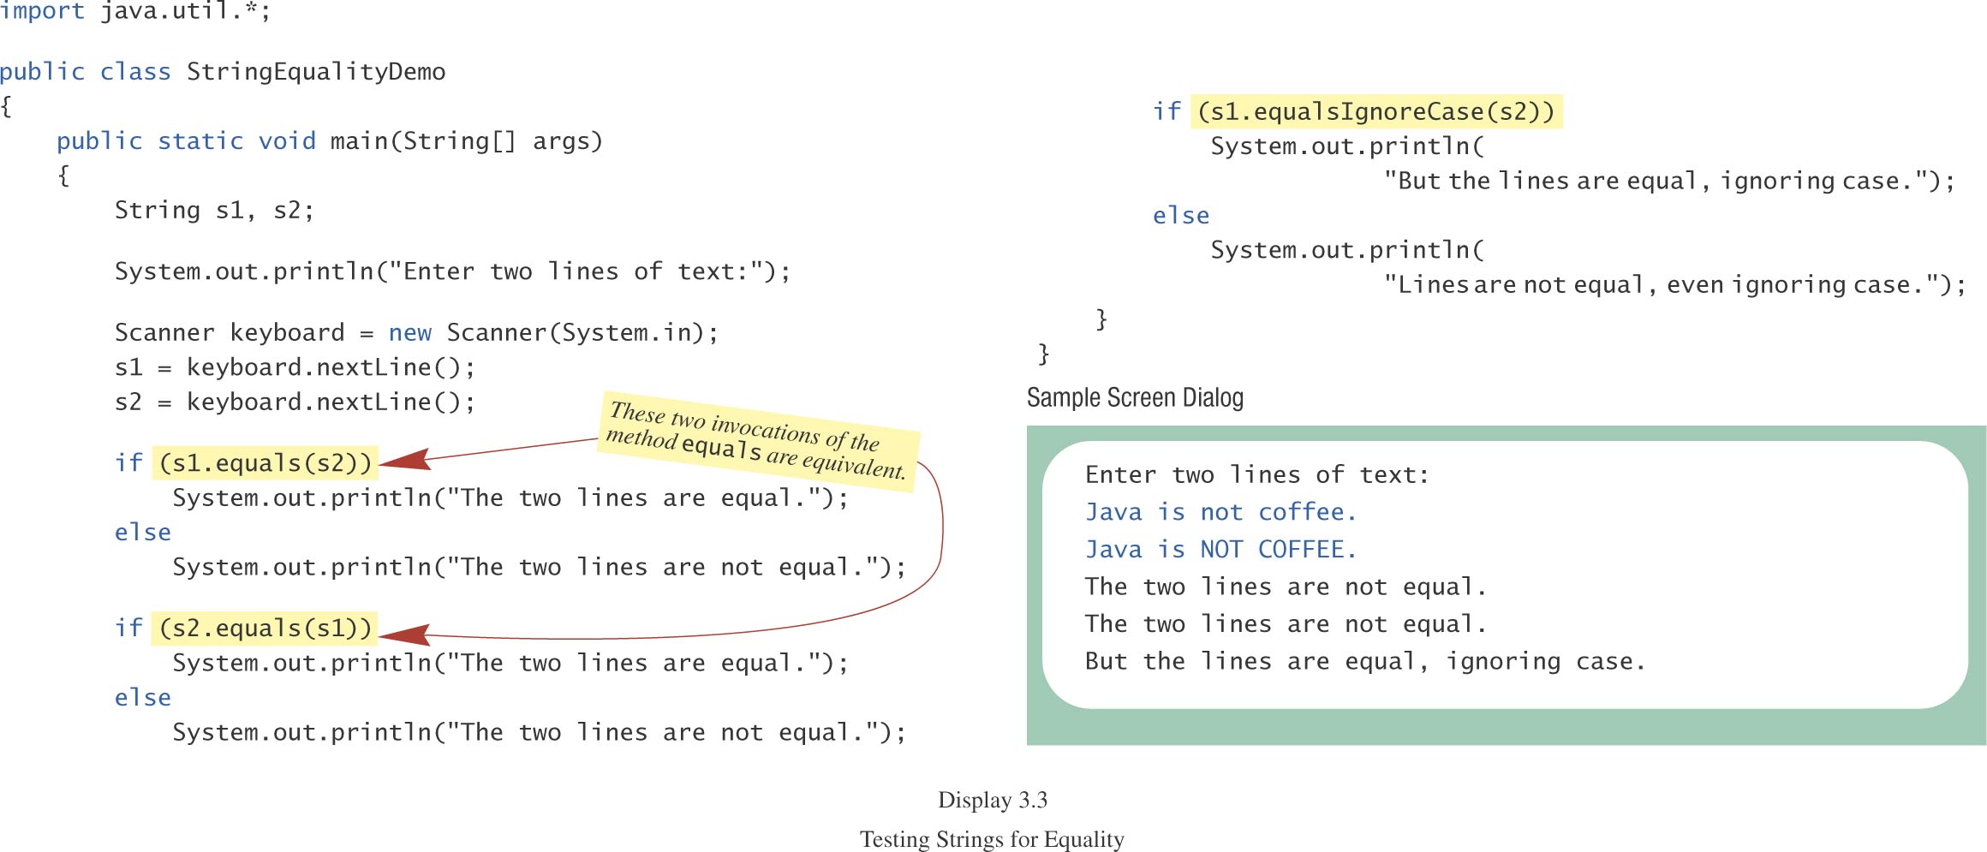
Testing Strings for Equality
class StringEqualityDemo

Slide 133
Lexicographic Order
Lexicographic order is similar to alphabetical order, but is it based on the order of the characters in the ASCII (and Unicode) character set.
All the digits come before all the letters.
All the uppercase letters come before all the lower case letters.

Slide 134
Lexicographic Order, cont.
Strings consisting of alphabetical characters can be compared using method compareTo and method toUpperCase or method toLowerCase.
String s1 = “Hello”;
String lowerS1 = s1.toLowerCase();
String s2 = “hello”;
if (lowerS1.compareTo(s2) == 0)
System.out.println(“Equal!”);
//or use s1.compareToIgnoreCase(s2)

Slide 135
Method compareTo
syntax
String_1.compareTo(String_2)
Method compareTo returns
a negative number if String_1 precedes String_2
zero if the two strings are equal
a positive number of String_2 precedes String_1
Tip: Think of compareTo is subtraction

Slide 136
Comparing Numbers vs. Comparing Strings
Integer and floating-point values | String objects
== != | equals( ) equalsIgnoreCase( )
> < >= <= | compareTo( ) [lexicographical ordering]

Slide 137
Nested Statements
An if-else statement can contain any sort of statement within it.
In particular, it can contain another if-else statement.
An if-else may be nested within the “if” part.
An if-else may be nested within the “else” part.
An if-else may be nested within both parts.

Slide 138
Nested Statements, cont.
syntax
if (Boolean_Expression_1)
if (Boolean_Expression_2)
Statement_1
else
Statement_2
else
if (Boolean_Expression_3)
Statement_3
else
Statement_4

Slide 139
Nested if Example
if (temperature > 90) // int temperature
if (sunny) // boolean sunny
System.out.println(“Beach”);
else
System.out.println(“Movie”);
else
if (sunny)
System.out.println(“Tennis”);
else
System.out.println(“Volleyball”);

Slide 140
Nested Statements, cont.
Each else is paired with the nearest unmatched if.
Indentation can communicate which if goes with which else.
Braces are used to group statements.

Slide 141
Nested Statements, cont.
Different indentation
first form second form
if (a > b) if (a > b)
if (c > d) if (c > d)
e = f; e = f;
else else
g = h; g = h;
Same to the compiler!

Slide 142
Nested Statements, cont.
Are these different?
first form second form
if (a > b) if (a > b)
{ if (c > d)
if (c > d) e = f;
e = f; else
} g =h;
else
g = h;

Slide 143
Nested Statements, cont.
Proper indentation and nested if-else statements
“else” with outer “if” “else” with inner “if”
if (a > b) if (a > b)
{ if (c > d)
if (c > d) e = f;
e = f; else
} g =h;
else
g = h;

Slide 144
Compound Statements
When a list of statements is enclosed in braces ({}), they form a single compound statement.
syntax
{
Statement_1;
Statement_2;
…
}

Slide 145
Compound Statements, cont.
A compound statement can be used wherever a statement can be used.
example
if (total > 10)
{
sum = sum + total;
total = 0;
}

Slide 146
Multibranch if-else Statements
syntax
if (Boolean_Expression_1)
Statement_1
else if (Boolean_Expression_2)
Statement_2
else if (Boolean_Expression_3)
Statement_3
else if …
else
Default_Statement

Slide 147
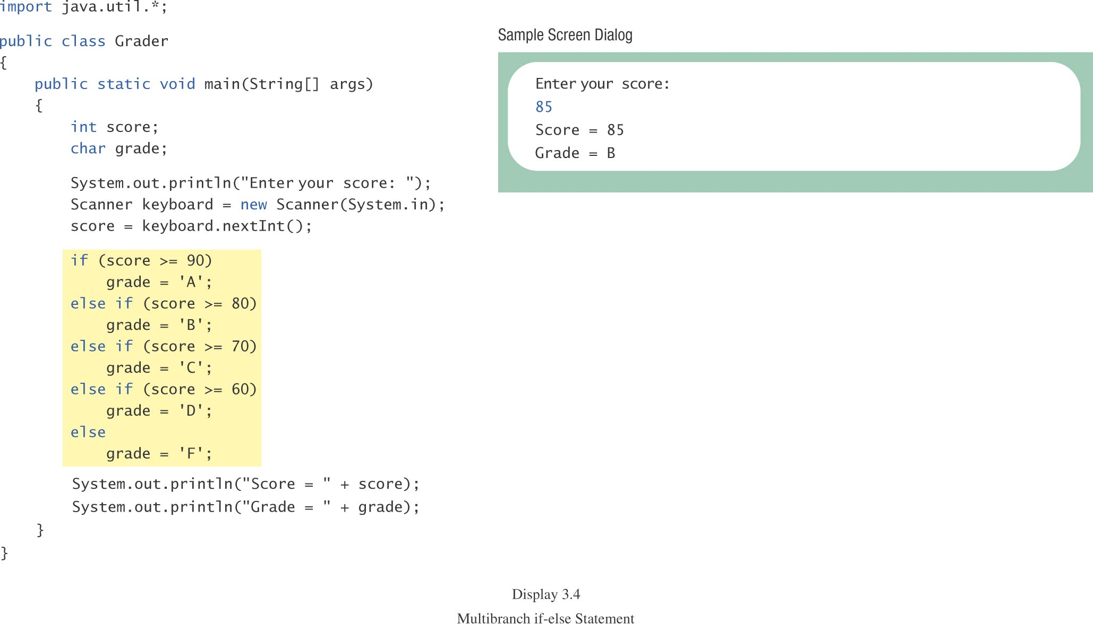
Multibranch if-else Statements, cont.
class Grader

Slide 148
Multibranch if-else Statements, cont.
equivalent logically
if (score >= 90)
grade = ‘A’;
if ((score >= 80) && (score < 90))
grade = ‘B’;
if ((score >= 70) && (score < 80))
grade = ‘C’;
if ((score >= 60) && (score < 70))
grade = ‘D’;
if (score < 60)
grade = ‘F’;

Slide 149
switch Statement
The switch statement is a multiway branch that makes a decision based on an integral (integer or character) expression.
The switch statement begins with the keyword switch followed by an integral expression in parentheses and called the controlling expression.

Slide 150
switch Statement, cont.
A list of cases follows, enclosed in braces.
Each case consists of the keyword case followed by
a constant called the case label
a colon
a list of statements.
The list is searched for a case label matching the controlling expression.

Slide 151
switch Statement, cont.
The action associated with a matching case label is executed.
If no match is found, the case labeled default is executed.
The default case is optional, but recommended, even if it simply prints a message.
Repeated case labels are not allowed.

Slide 152
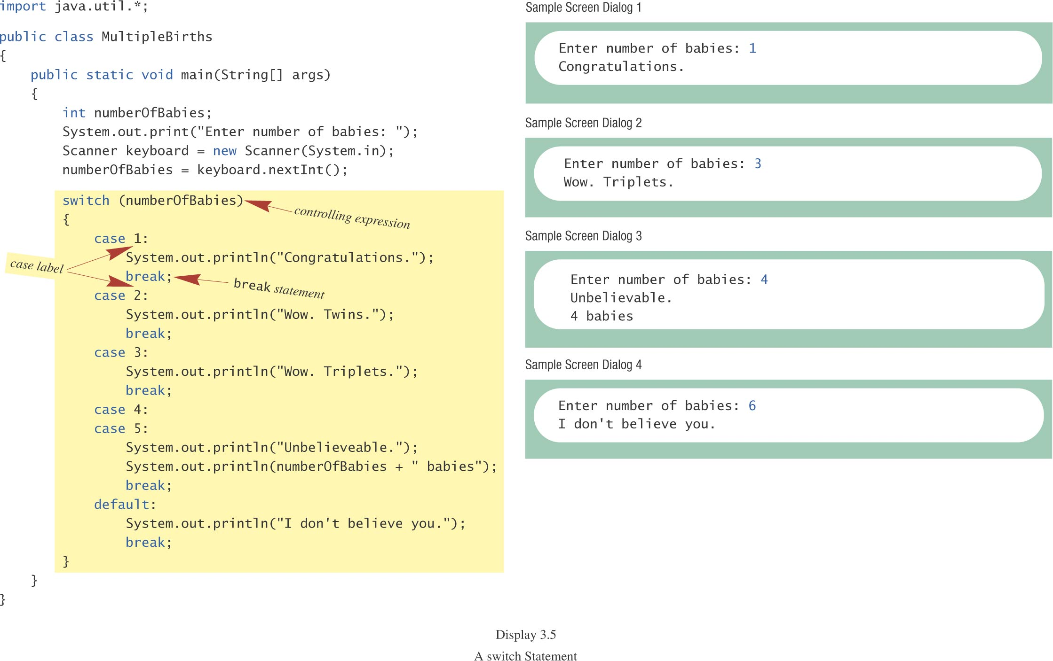
switch Statement, cont.
class MultipleBirths

Slide 153
switch Statement, cont.
The action for each case typically ends with the word break.
The optional break statement prevents the consideration of other cases.
The controlling expression can be anything that evaluates to an integral type (integer or character).

Slide 154
The switch Statement, cont.
syntax
switch (Controlling_Expression)
{
case Case_Label:
Statement(s);
break;
case Case_Label:
…
default:
…
}

Slide 155
Switch with char Type
char grade = 'A';
switch(grade)
{
case 'A':
case 'B':
case 'C':
case 'D':
System.out.println("Pass");
break;
case 'W':
System.out.println("Withdraw");
break;
case 'I':
System.out.println("Incomplete");
break;
default:
System.out.println("Fail");
}

Slide 156
Conditional Operator
if (n1 > n2)
max = n1;
else
max = n2;
can be written as
max = (n1 > n2) ? n1 : n2;
The ? and : together is called the conditional operator (a ternary operator).
Note (n1 > n2) ? n1 : n2 is an expression that has a value unlike the “normal” if statement

Slide 157
Conditional Operator, cont.
The conditional operator can be useful with print statements.
System.out.print(“You worked “ + hours + “ “ +
((hours > 1) ? “hours” : “hour”));

Slide 158
Summary of branching
if statement (1 or 2 branches)
Multi-branch if-else-if statement (3 or more branches)
Multi-branch switch statement
Conditional operator ? :

Slide 159
Loop Statements
A portion of a program that repeats a statement or a group of statements is called a loop.
The statement or group of statements to be repeated is called the body of the loop.
A loop could be used to compute grades for each student in a class.
There must be a means of exiting the loop.

Slide 160
Loop Structure
Control of loop: ICU
Initialization
Condition for termination (continuing)
Updating the condition
Body of loop

Slide 161
Loop Statements
the while Statement
the do-while Statement
the for Statement

Slide 162
while Statement
also called a while loop
a controlling boolean expression
True -> repeats the statements in the loop body
False -> stops the loop
Initially false (the very first time)
loop body will not even execute once

Slide 163
while Statement, cont.
syntax
while (Boolean_Expression)
Body_Statement
or
while (Boolean_Expression)
{
First_Statement
Second_Statement
…
}

Slide 164
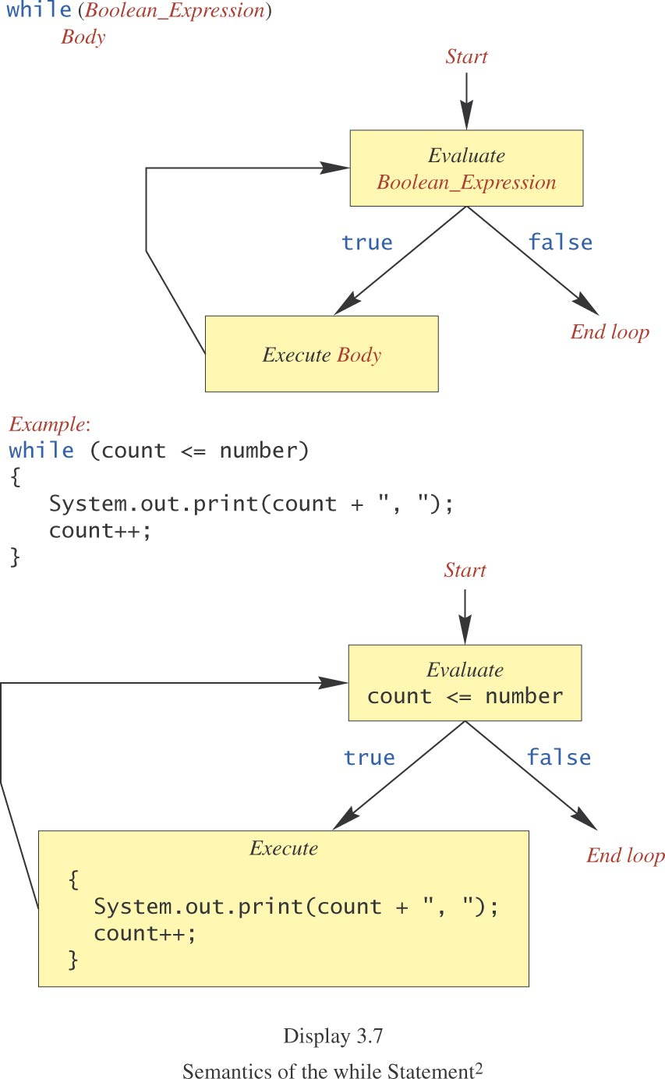
while Statement, cont.

Slide 165
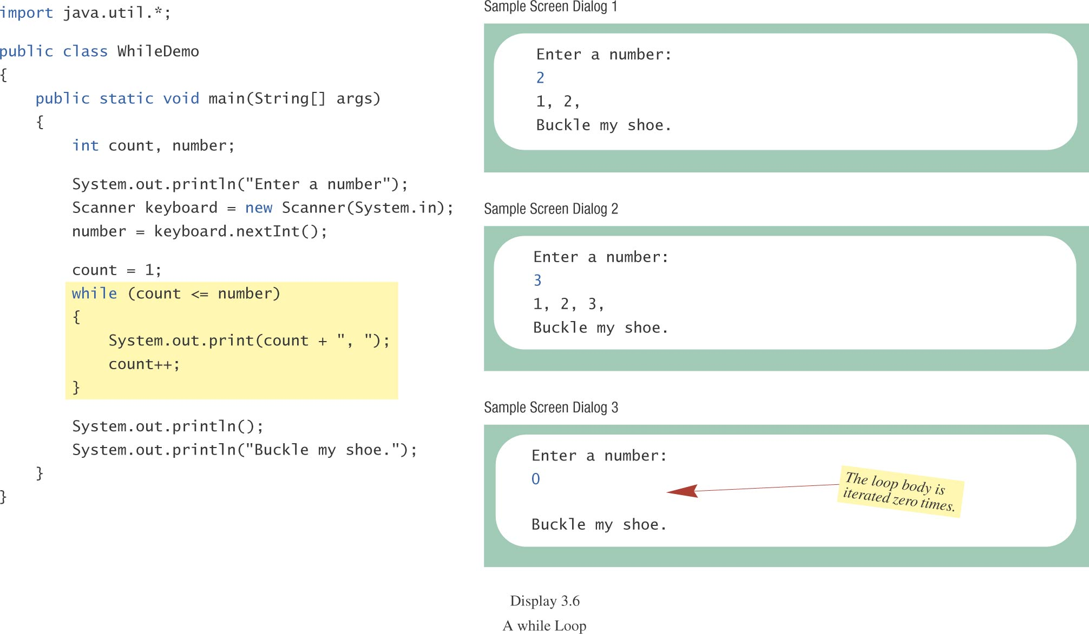
while Statement, cont.
class WhileDemo

Slide 166
do-while Statement
also called a do-while loop (repeat-until loop)
similar to a while statement
except that the loop body is executed at least once
syntax
do
Body_Statement
while (Boolean_Expression);
don’t forget the semicolon at the end!

Slide 167
do-while Statement, cont.
First, the loop body is executed.
Then the boolean expression is checked.
As long as it is true, the loop is executed again.
If it is false, the loop exits.
equivalent while statement
Statement(s)_S1
while (Boolean_Condition)
Statement(s)_S1

Slide 168
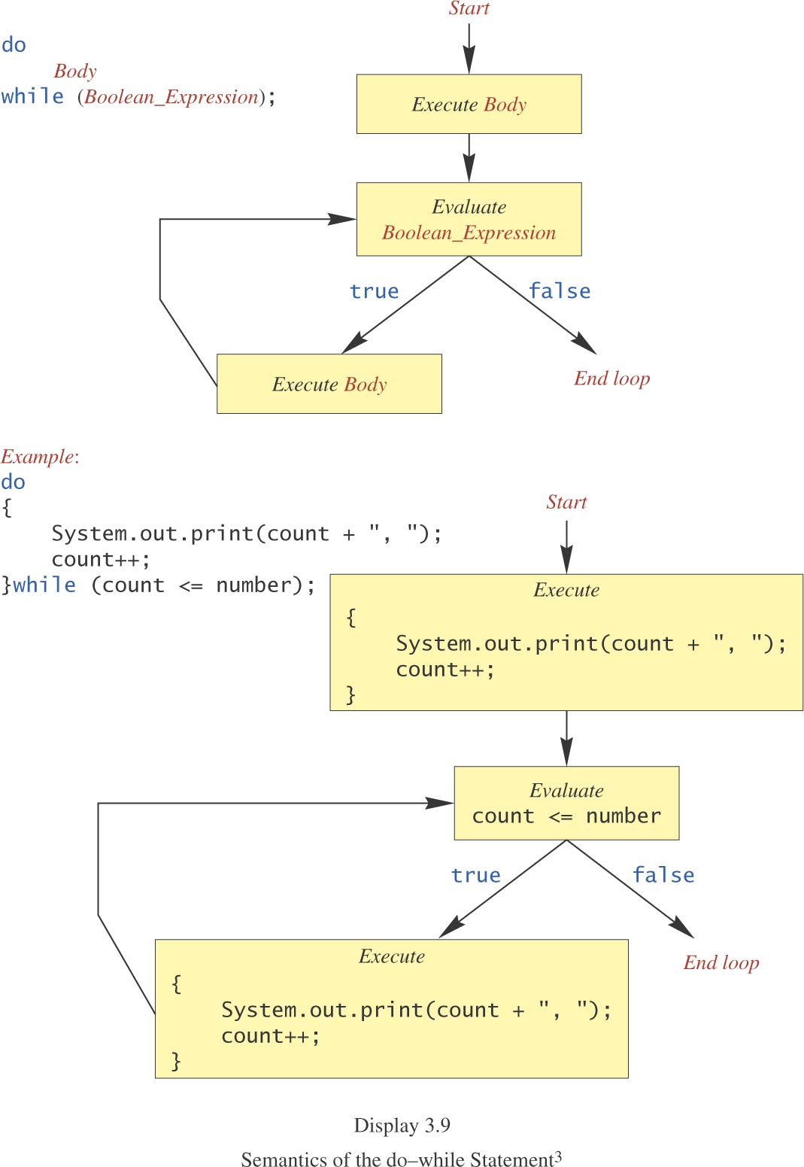
do-while Statement, cont.

Slide 169
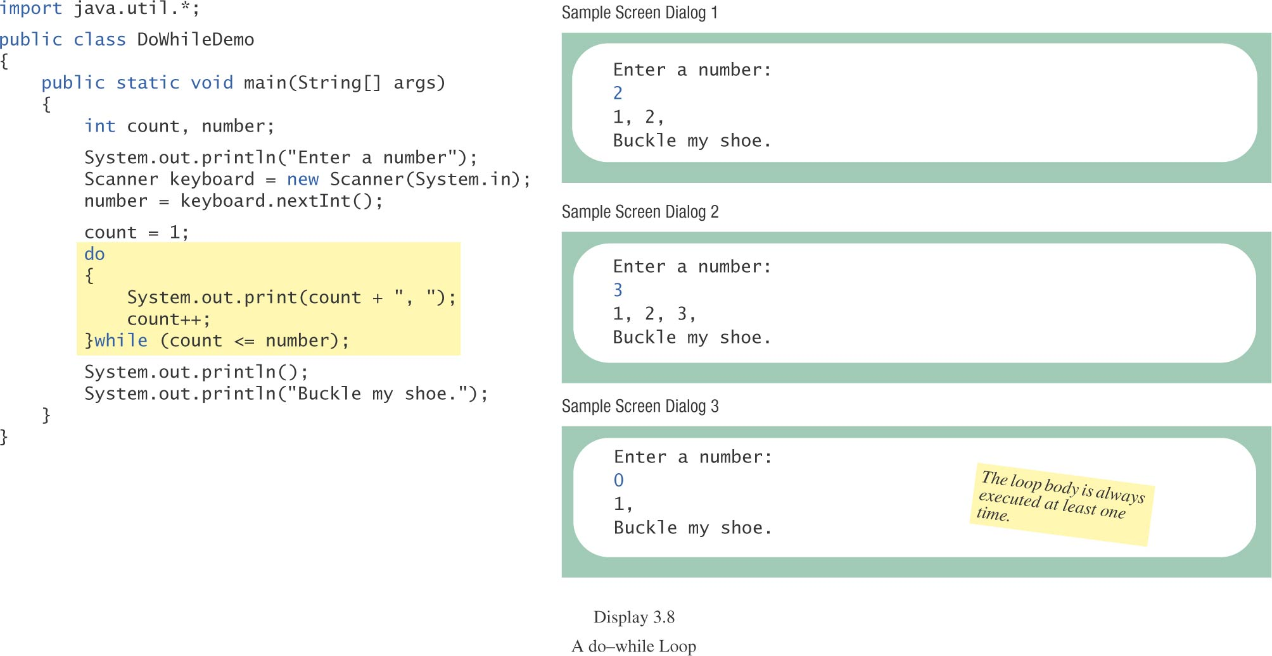
do-while Statement, cont.
class DoWhileDemo

Slide 170
Programming Example: Bug Infestation
given
volume of a roach: 0.0002 cubic feet
starting roach population
rate of increase: 95%/week
volume of a house
find
number of weeks to exceed the capacity of the house
number and volume of roaches

Slide 171
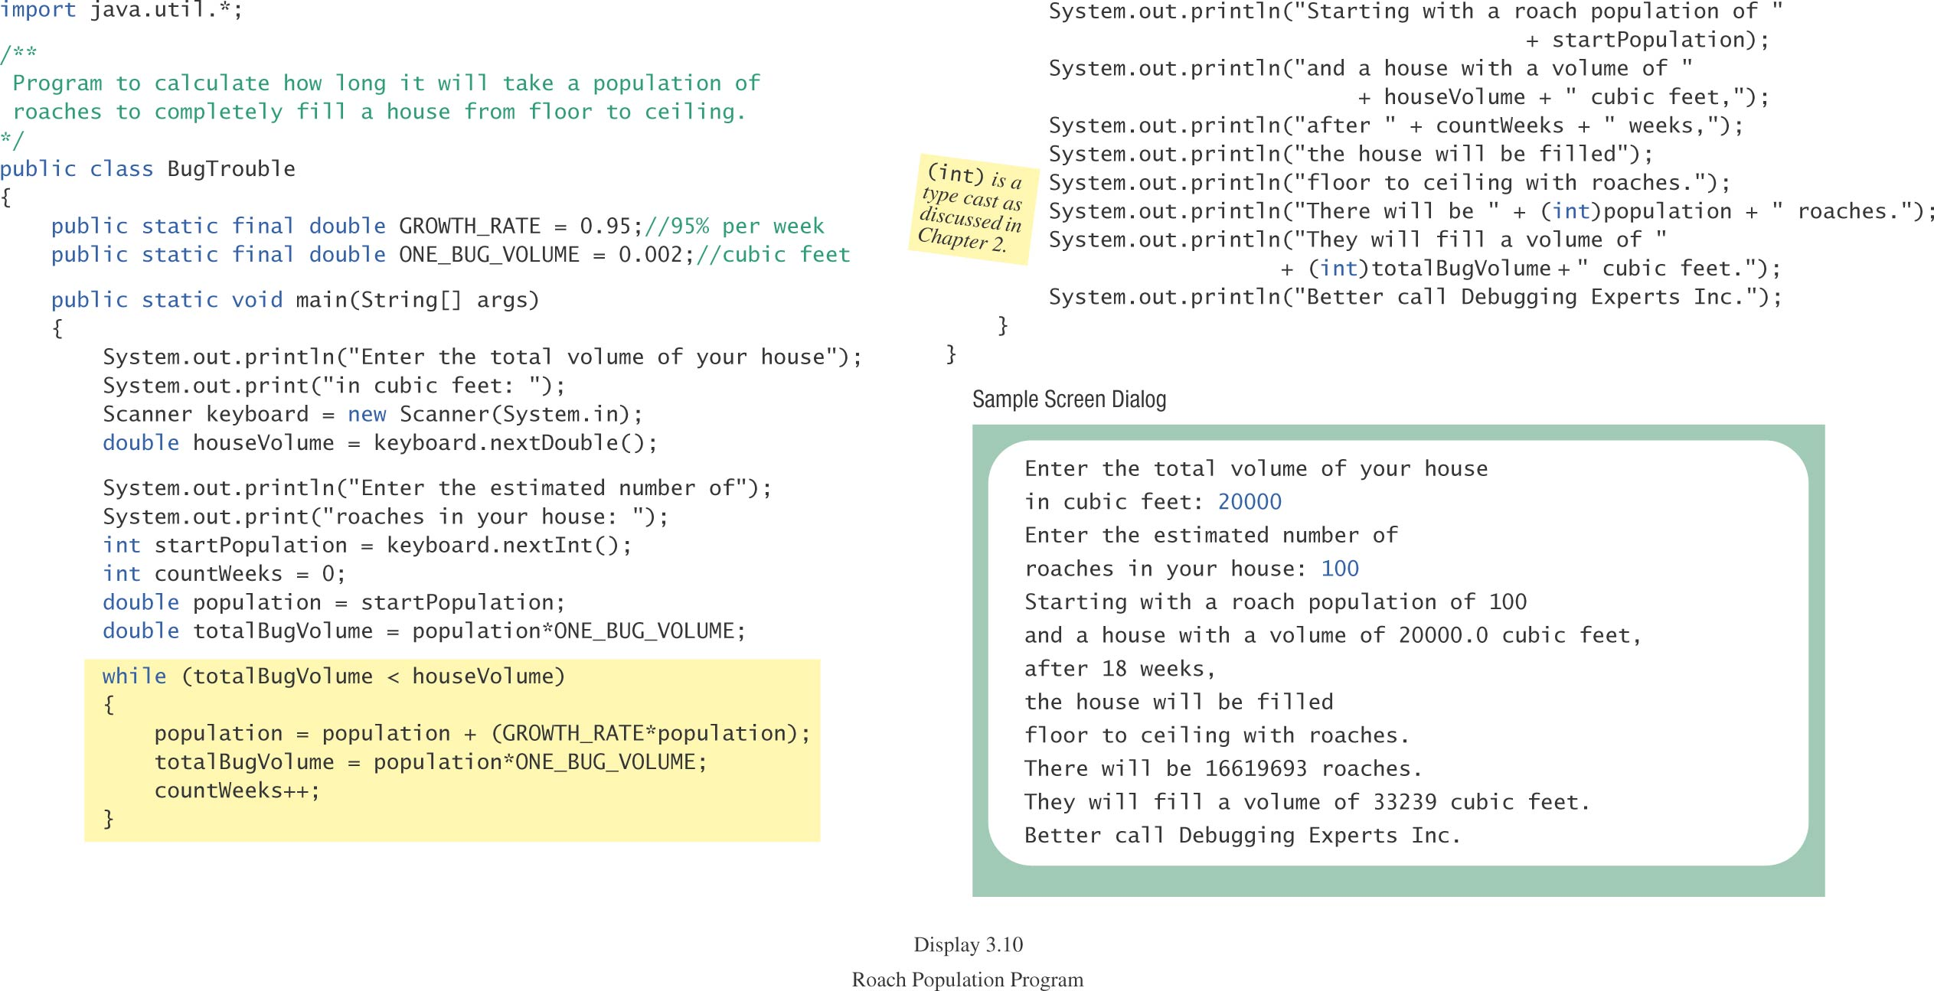
Programming Example: Bug Infestation, cont.
class BugTrouble

Slide 172
Infinite Loops
A loop which repeats without ever ending
the controlling boolean expression (condition to continue)
never becomes false
A negative growth rate in the preceding problem causes totalBugVolume always to be less than houseVolume
the loop never ends.

Slide 173
for Statement
A for statement executes the body of a loop a fixed number of times.
example
for (count = 1; count < 3; count++)
System.out.println(count);
System.out.println(“Done”);

Slide 174
for Statement, cont.
syntax
for (Initialization; Condition; Update)
Body_Statement
Body_Statement
a simple statement or
a compound statement in {}.
corresponding while statement
Initialization
while (Condition)
Body_Statement_Including_Update

Slide 175
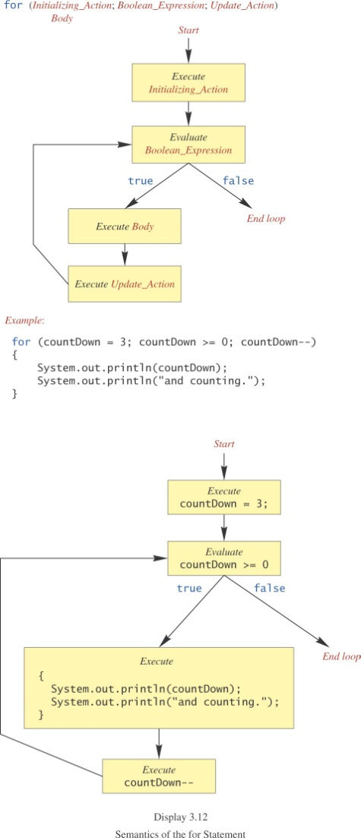
for Statement, cont.

Slide 176
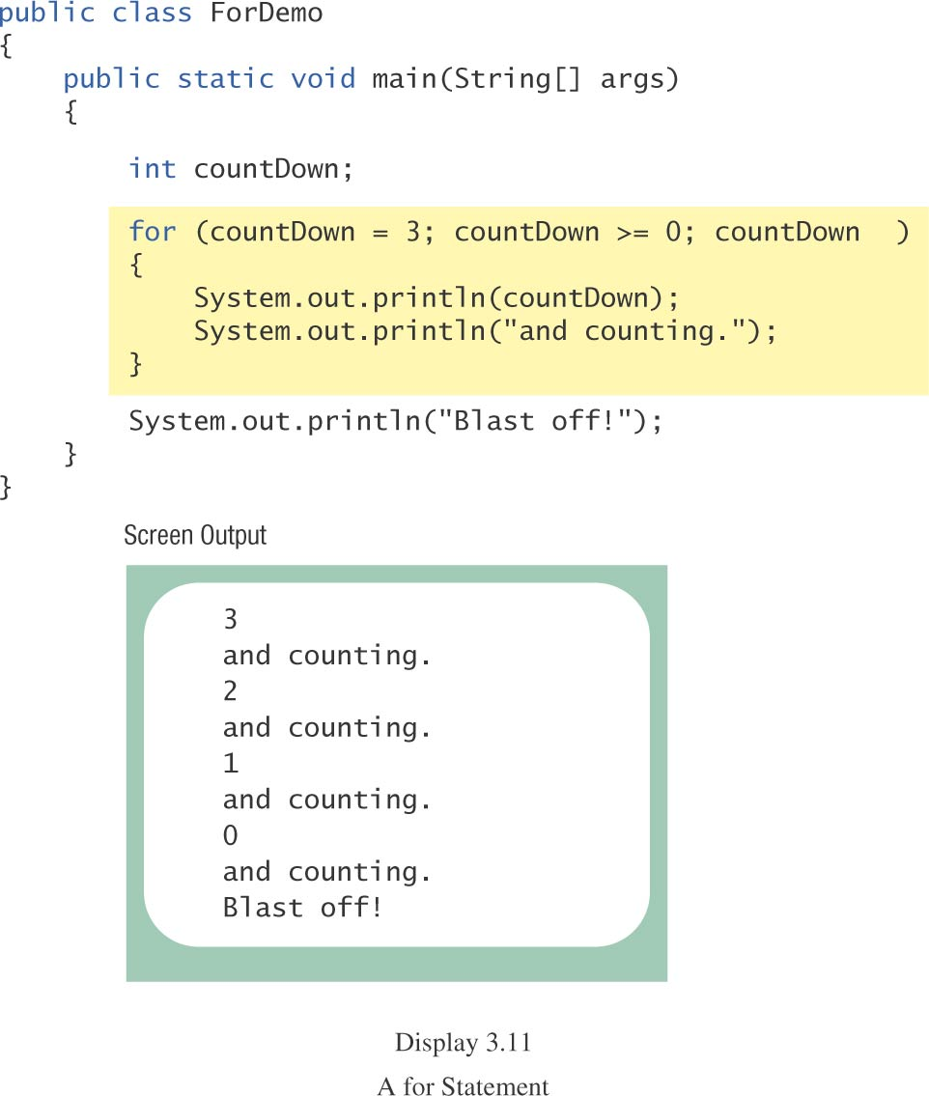
for Statement, cont.
class ForDemo

Slide 177
Multiple Initialization, etc.
example
for (n = 1, p = 1; n < 10; n++)
p = p * n
Only one boolean expression is allowed, but it can consist of &&s, ||s, and !s.
Multiple update actions are allowed, too.
for (n = 1, p = 100; n < p; n++, p -= n)
rarely used

Slide 178
Choosing a Loop Statement
If you know how many times the loop will be iterated, use a for loop.
If you don’t know how many times the loop will be iterated, but
it could be zero, use a while loop
it will be at least once, use a do-while loop.
Generally, a while loop is a safe choice.

Slide 179
Summary of loop statements
while loop
do-while loop
for loop

Slide 180
break Statement in Loops: NOT recommended
A break statement can be used to end a loop immediately.
The break statement ends only the innermost loop that contains the break statement.
break statements make loops more difficult to understand:
Loop could end at different places (multiple possible exit points), harder to know where.
Always try to end a loop at only one place--makes debugging easier (only one possible exit point)

Slide 181
Misuse of break Statements in loops (p. 177)
“Because of the complications they introduce, break statements in loops should be avoided.
Some authorities contend that a break statement should never be used to end a loop,
but virtually all programming authorities agree that they should be used at most sparingly.”

Slide 182
exit Method
Sometimes a situation arises that makes continuing the program pointless.
A program can be terminated normally by
System.exit(0).
example
if (numberOfWinners == 0)
{
System.out.println(“/ by 0”);
System.exit(0);
}

Slide 183
Programming with Loops: Outline
The Loop Body
Initializing Statements
Ending a Loop
Loop Bugs
Tracing Variables

Slide 184
Loop Body
To design the loop body, write out the actions the code must accomplish.
Then look for a repeated pattern.
The pattern need not start with the first action.
The repeated pattern will form the body of the loop.
Some actions may need to be done after the pattern stops repeating.

Slide 185
Initializing Statements
Some variables need to have a value before the loop begins.
Sometimes this is determined by what is supposed to happen after one loop iteration.
Often variables have an initial value of zero or one, but not always.
Other variables get values only while the loop is iterating.

Slide 186
Ending a Loop
If the number of iterations is known before the loop starts, the loop is called a count-controlled loop.
use a for loop.
Asking the user before each iteration if it is time to end the loop is called the ask-before-iterating technique.
appropriate for a small number of iterations
Use a while loop or a do-while loop.

Slide 187
Ending a Loop, cont.
For large input lists, a sentinel value can be used to signal the end of the list.
The sentinel value must be different from all the other possible inputs.
A negative number following a long list of nonnegative exam scores could be suitable.
90
0
10
-1

Slide 188
Ending a Loop, cont.
example - reading a list of scores followed by a sentinel value
int next = keyboard.nextInt();
while (next >= 0)
{
Process_The_Score
next = keyboard.nextInt();
}

Slide 189
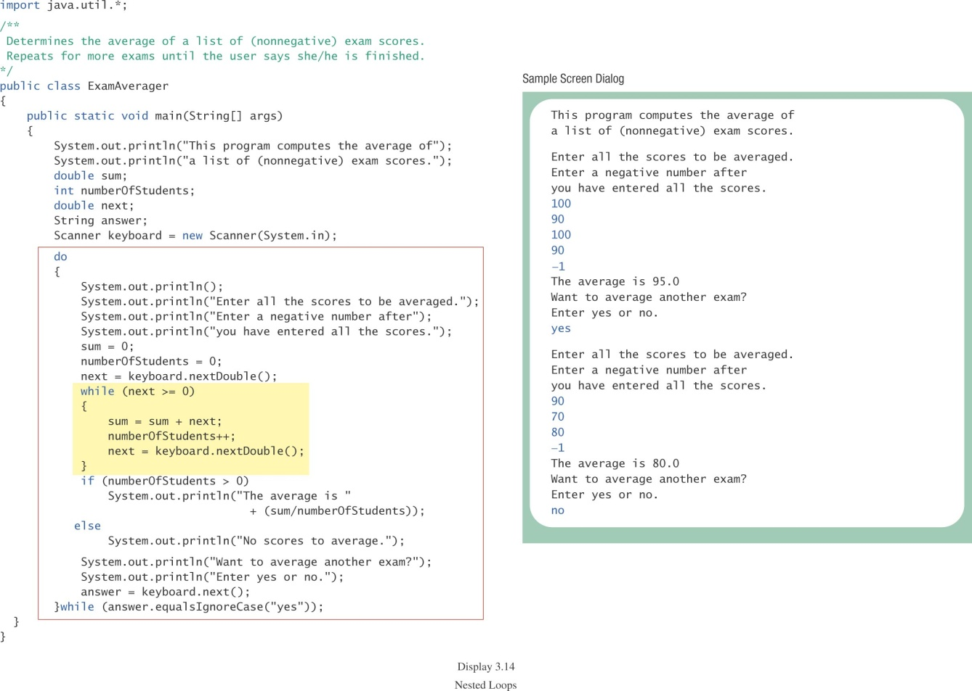
Ending a Loop, cont.
class ExamAverager

Slide 190
Nested Loops
The body of a loop can contain any kind of statements, including another loop.
In the previous example
the average score was computed using a while loop.
This while loop was placed inside a do-while loop so the process could be repeated for other sets of exam scores.

Slide 191
Nested Loops
The body of a loop can have any kind of statements, including another loop.
Each time the outer loop body is executed, the inner loop body will execute 5 times.
20 times total
for (line = 0; line < 4; line++)
{
for (star = 0; star < 5; star++)
System.out.print('*');
System.out.println();
}
body of outer loop
body of inner loop
*****
*****
*****
*****
Output:

Slide 192
Declaring Variables Outside Loop Bodies
Declaration of variables inside a loop body is repeated with each execution of the loop body--can be inefficient
Declaration of variables can generally be moved outside the loop body.
while (…)
{
int x;
…
}

Slide 193
Loop Bugs
common loop bugs
unintended infinite loops
off-by-one errors
testing equality of floating-point numbers
subtle infinite loops
The loop may terminate for some input values, but not for others.
For example, you can’t get out of debt when the monthly penalty exceeds the monthly payment.

Slide 194
Off-by-One Errors
The loop body is repeated one too many times or one too few times.
examples
< is used when <= should be used or <= is used when < should be used
using the index of the last character of a string instead of the length of the string (or vice versa)
easy to overlook

Slide 195
Off by One
int i = 0;
while (i <= 10)
{
System.out.println(i);
i++;
}

Slide 196
Subtle Infinite Loops
Verify that the monthly payment exceeds the penalty, for example, before entering a loop to determine the number of payments needed to get out of debt.
if (payment <= penalty)
System.out.println(“payment is too small”);
else
{
...

Slide 197
Empty for Statement
What is printed by
int product = 1, number;
for (number = 1; number <= 10; number++);
product = product * number;
System.out.println(product);
The last semicolon in
for (number = 1; number <= 10; number++);
produces an empty for statement.

Slide 198
Empty while Statement
int product = 1, number = 1;
while (number <= 10);
{
product = product * number;
number++;
}
System.out.println(product);
The last semicolon in
while (number <= 10);
produces an empty while loop body.

Slide 199
Testing Equality of Floating-point Numbers
== works satisfactorily for integers and characters.
== is not reliable for floating-point numbers (which are approximate quantities).
Can cause infinite loops
Use <= or >= rather than == or !=.
www.cs.fit.edu/~pkc/classes/cse1001/FloatEquality.java

Slide 200
Tracing Variables
Tracing variables means watching the variables change while the program is running.
Simply insert temporary output statements in your program to print of the values of variables of interest
or, learn to use the debugging facility that may be provided by your system.

Slide 201
Tracing Variables, cont.
float creditCardBalance = 9000.0;
while (creditCardBalance > 0)
{
… // input payment
creditCardBalance -= payment;
… // calculate penalty
creditCardBalance += penalty;
system.out.println(creditCardBalance);
}

Slide 202
Type boolean
Boolean Expressions and Variables
Truth Tables and Precedence Rules
Input and Output of Boolean Values

Slide 203
Type boolean, cont.
The type boolean is a primitive type with only two values: true and false.
Boolean variables can make programs more readable.
if (systemsAreOK)
instead of
if((temperature <= 100) && (thrust >= 12000) && (cabinPressure > 30) && …)

Slide 204
Boolean Expressions and Variables
Variables, constants, and expressions of type boolean all evaluate to either true or false.
A boolean variable can be given the value of a boolean expression by using an assignment operator.
boolean isPositive = (number > 0);
...
if (isPositive) ...

Slide 205
Naming Boolean Variables
Choose names such as isPositive or systemsAreOk.
Avoid names such as numberSign or systemStatus.

Slide 206
Precedence Rules
Parentheses should be used to indicate the order of operations.
When parentheses are omitted, the order of operation is determined by precedence rules.

Slide 207
Precedence Rules, cont.
Operations with higher precedence are performed before operations with lower precedence.
Operations with equal precedence are done left-to-right (except for unary operations which are done right-to-left).

Slide 208
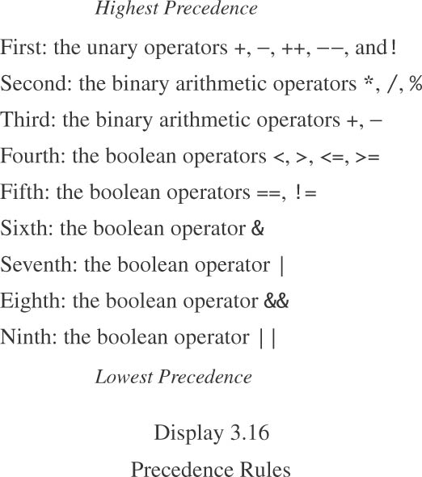
Precedence Rules, cont.
Comparison operators:
<, >, <=, >=
==, !=
Logical operators:
&
|
&&
||

Slide 209
Precedence Rules, cont.
In what order are the operations performed?
score < min/2 - 10 || score > 90
score < (min/2) - 10 || score > 90
score < ((min/2) - 10) || score > 90
(score < ((min/2) - 10)) || score > 90
(score < ((min/2) - 10)) || (score > 90)

Slide 210
Short-circuit Evaluation
Sometimes only part of a boolean expression needs to be evaluated to determine the value of the entire expression.
If the first operand of || is true
entire expression is true
If the first operand of && is false
entire expression is false
This is called short-circuit or lazy evaluation.

Slide 211
Short-circuit Evaluation, cont.
Short-circuit evaluation is not only efficient, sometimes it is essential!
A run-time error can result, for example, from an attempt to divide by zero.
if ((number != 0) && (sum/number > 5))
Complete evaluation can be achieved by substituting & for && or | for ||.

Slide 212
Short-circuit Evaluation
int count = 1;
…
if ( … && (++count < 10) )
{
…
}
System.out.println(count);

Slide 213
Input and Output of Boolean Values
example
boolean boo = false;
System.out.println(boo);
System.out.print(“Enter a boolean value: “);
Scanner keyboard = new Scanner (System.in);
boo = keyboard.nextBoolean();
System.out.println(boo);

Slide 214
Input and Output of Boolean Values, cont.
dialog
false
Enter a boolean value: true
true

Slide 215
Using a Boolean Variable to End a Loop
example
boolean numbersLeftToRead = true;
while (numbersLeftToRead)
{
next = keyboard.nextInt();
if (next < 0)
numbersLeftToRead = false;
else
Process_Next_Number
}

Slide 216
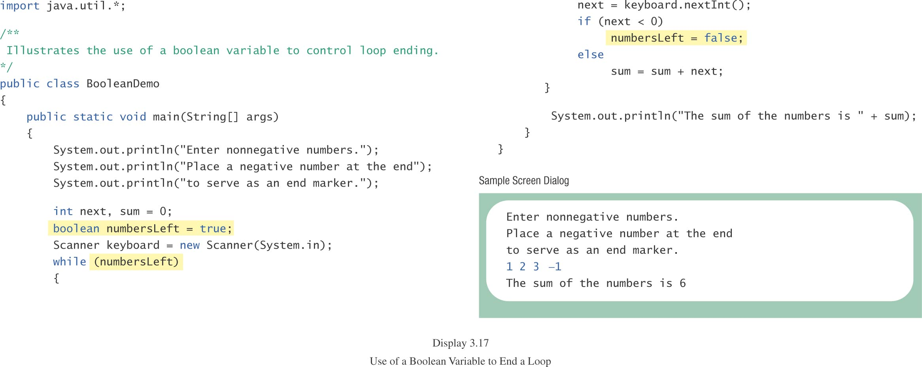
Using a Boolean Variable to End a Loop, cont
class BooleanDemo

Slide 217
Summary
You have learned about Java branching statements.
You have learned about loops.
You have learned about the type boolean.

Slide 218
New features from Java 5 to Java 7
JAVA 5 Features
The important features of J2SE 5 are generics and assertions. Others are auto-boxing, enum, var-args, static import, for-each loop (enhanced for loop etc.
For-each loop (Java 5)
Varargs (Java 5)
Static Import (Java 5)
Auto boxing and Unboxing (Java 5)
Enum (Java 5)
Covariant Return Type (Java 5)
Annotation (Java 5)
Generics (Java 5)

Slide 219
JavaSE 6 Features
The important feature of JavaSE 6 is premain method (also known as instrumentation).
Instrumentation

Slide 220
JavaSE 7 Features
The important features of JavaSE 7 are try with resource, catching multiple exceptions etc.
String in switch statement (Java 7)
Binary Literals (Java 7)
The try-with-resources (Java 7)
Caching Multiple Exceptions by single catch (Java 7)
Underscores in Numeric Literals (Java 7)

Slide 221
Enhanced for loop
Enhanced for loop is useful when scanning the array instead of using for loop.
Syntax of enhanced for loop is: for (data_type variable: array_name)
Here array_name is the name of array.
class EnhancedForLoop {
public static void main(String[] args) {
int primes[] = { 2, 3, 5, 7, 11, 13, 17, 19, 23, 29};
for (int t: primes) {
System.out.println(t);
}
}
}

Slide 222
For-each loop (Advanced/Enhanced For loop)
The for-each loop introduced in Java5. It is mainly used to traverse array or collection elements. The advantage of for-each loop is that it eliminates the possibility of bugs and makes the code more readable.
Advantage of for-each loop:
It makes the code more readable.
It eliminates the possibility of programming errors.
Syntax of for-each loop:
for(data_type variable : array | collection){}

Slide 223
SWITCH CASE STATEMENT
A switch statement allows a variable to be tested for equality against a list of values. Each value is called a case, and the variable being switched on is checked for each case.

Slide 224
SWITCH CASE STATEMENT
Syntax
The syntax of enhanced for loop is −
switch(expression) { case value :
// Statements break; // optional
case value :
// Statements break; //optional
// You can have any number of case statements. default : // Optional
// Statements}

Slide 225
Java String
In java, string is basically an object that represents sequence of char values. An array of characters works same as java string. For example:
char[] ch={'j','a','v','a','t','p','o','i','n','t'};
String s=new String(ch);
is same as:
String s="javatpoint";

Slide 226
Java String class provides a lot of methods to perform operations on string such as compare(), concat(), equals(), split(), length(), replace(), compareTo(), intern(), substring() etc.
The java.lang.String class implements Serializable, Comparable and CharSequence interfaces.

Slide 227
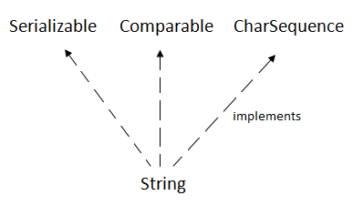

Slide 228
Char Sequence Interface
The CharSequence interface is used to represent sequence of characters. It is implemented by String, StringBuffer and StringBuilder classes. It means, we can create string in java by using these 3 classes.

Slide 229
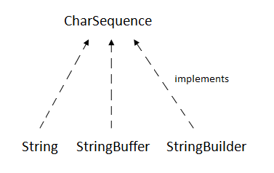

Slide 230
The java String is immutable i.e. it cannot be changed. Whenever we change any string, a new instance is created. For mutable string, you can use StringBuffer and StringBuilder classes.
We will discuss about immutable string later. Let's first understand what is string in java and how to create the string object.

Slide 231
What is String in java
Generally, string is a sequence of characters. But in java, string is an object that represents a sequence of characters. The java.lang.String class is used to create string object.
How to create String object?
There are two ways to create String object:
By string literal
By new keyword

Slide 232
1) String Literal
Java String literal is created by using double quotes. For Example:
String s="welcome";
Each time you create a string literal, the JVM checks the string constant pool first. If the string already exists in the pool, a reference to the pooled instance is returned. If string doesn't exist in the pool, a new string instance is created and placed in the pool. For example:
String s1="Welcome";
String s2="Welcome";//will not create new instance

Slide 233
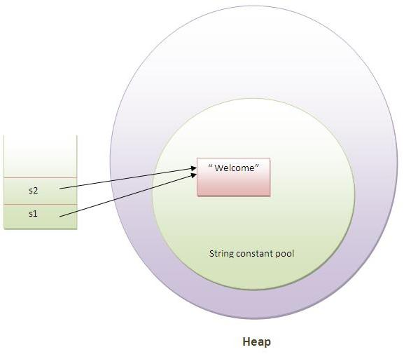

Slide 234
In the above example only one object will be created. Firstly JVM will not find any string object with the value "Welcome" in string constant pool, so it will create a new object. After that it will find the string with the value "Welcome" in the pool, it will not create new object but will return the reference to the same instance.
Note: String objects are stored in a special memory area known as string constant pool.
Why java uses concept of string literal?
To make Java more memory efficient (because no new objects are created if it exists already in string constant pool).

Slide 235
2) By new keyword
String s=new String("Welcome");
In such case, JVM will create a new string object in normal(non pool) heap memory and the literal "Welcome" will be placed in the string constant pool. The variable s will refer to the object in heap(non pool).
Java String Example
public class StringExample{
public static void main(String args[]){
String s1="java";//creating string by java string literal
char ch[]={'s','t','r','i','n','g','s'};
String s2=new String(ch);//converting char array to string
String s3=new String("example");//creating java string by new keyword
System.out.println(s1);
System.out.println(s2);
System.out.println(s3);
}}
javastrings

